Slide 1
#TwitterBot #Summarizer Konrad Piąstka, Dominika Leszko, Joana Lorenz, Lukas Früchtnicht

Slide 2
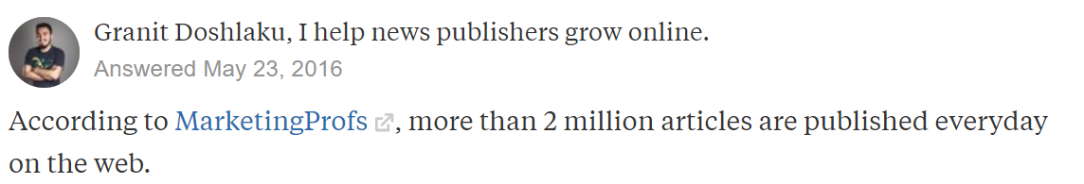
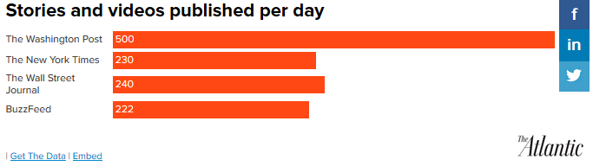
More than 2M articles a day
Background

Slide 3
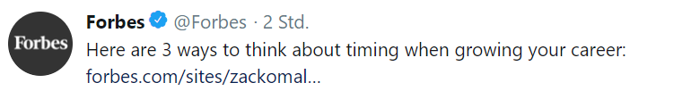

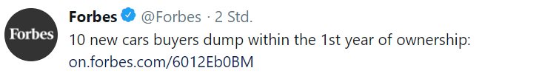
Titles often don‘t say much
Background

Slide 4
The objective
Background
Automatically generating and posting a summary with:
no more than 280 characters
relevant hashtags and mentions
link and title included in the post
Notes:
we also include a picture with the link ;)

Slide 5
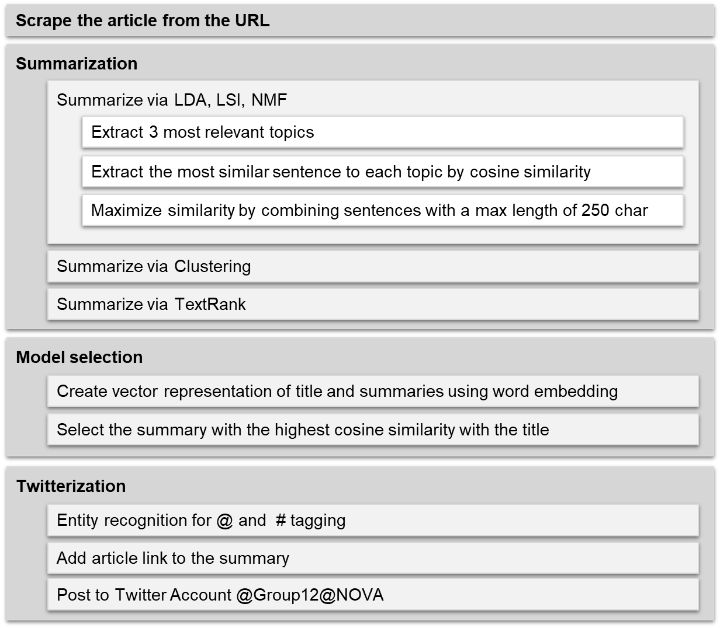
Methodology

Slide 6
Methodology

Slide 7
Methodology

Slide 8
Methodology

Slide 9
Methodology

Slide 10
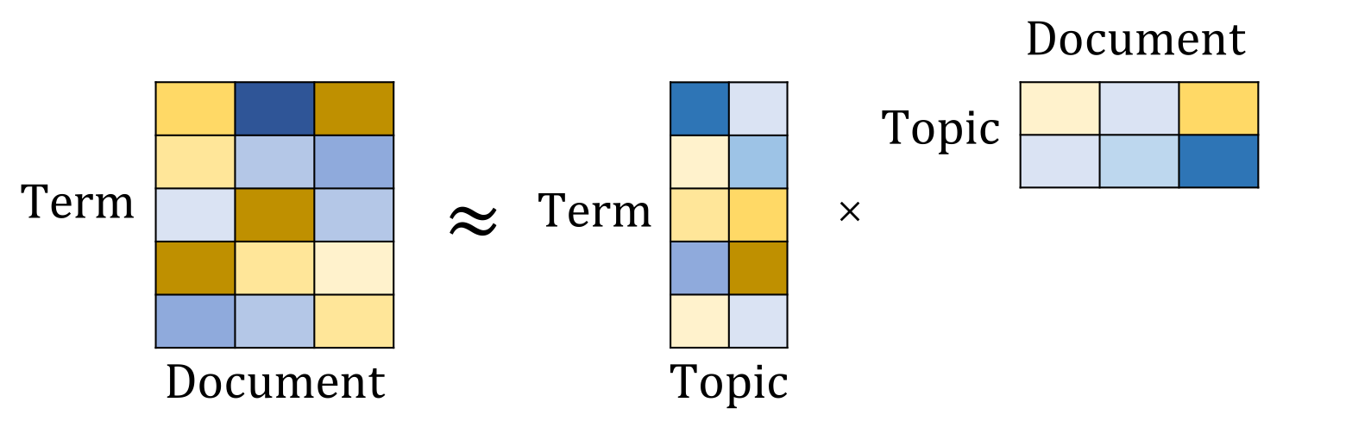
Topic Extraction
Summarization
Latent Dirichlet Allocation LDA, Latent Semantic Indexing LSI
Non-negative Matrix Factorization NMF
https://medium.com/ml2vec/topic-modeling-is-an-unsupervised-learning-approach-to-clustering-documents-to-discover-topics-fdfbf30e27df
Arora, Ge, Halpern, Mimno, Moitra, Sontag, Wu, & Zhu (2013)
Notes:
NMF: break down term-document matrix into lower dimensional form, namely a term-topic and topic-document matrix. The non-negativity makes it easier to interpret the results.
Non-negative Matrix Factorization is a Linear-algeabreic model, that factors high-dimensional vectors into a low-dimensionality representation. Similar to Principal component analysis (PCA), NMF takes advantage of the fact that the vectors are non-negative. By factoring them into the lower-dimensional form, NMF forces the coefficients to also be non-negative.
Given the original matrix A, we can obtain two matrices W and H, such that A= WH. NMF has an inherent clustering property, such that W and H represent the following information about A:
A (Document-word matrix) — input that contains which words appear in which documents.
W (Basis vectors) — the topics (clusters) discovered from the documents.
H (Coefficient matrix) — the membership weights for the topics in each document.

Slide 11
Optimal number of topics?
Summarization
Number of topics/sentences per method
Rouge score:
Overlap of words between summary and first 3 sentences
→ Highest scores for most topics

Slide 12
Optimal number of topics?
Summarization
Number of topics/sentences per method
Rouge score:
Overlap of words between summary and first 3 sentences
→ Highest scores for most topics
Normalization?

Slide 13
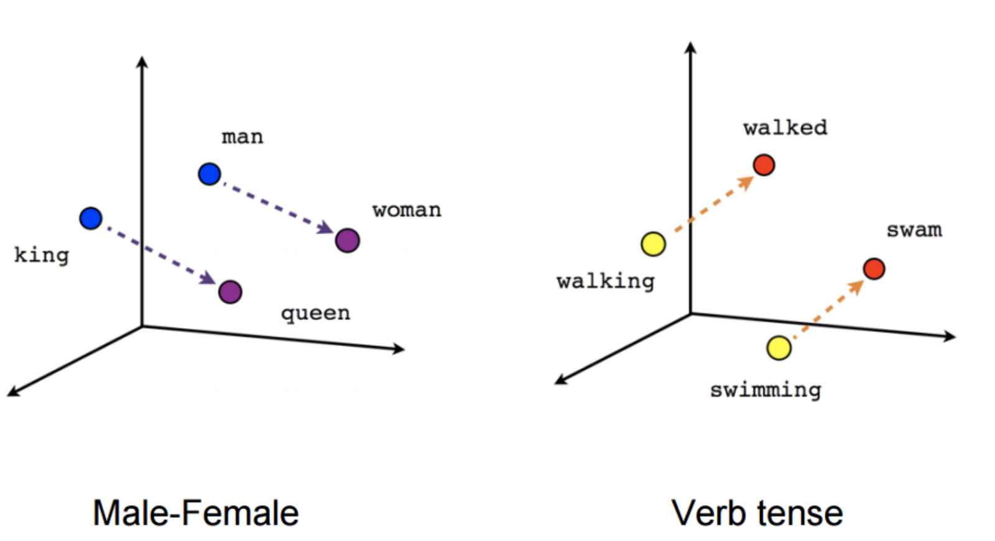
Word embedding
Model Evaluation
Word embedding using word2vec - representing words in vector space - is capable of capturing the ‘context’ of a word in a document, semantic and syntactic similarity, the relation with other words, etc.
“Have a good day” vs. “Have a great day”
Tomas Mikolov, Kai Chen, Greg Corrado, and Jeffrey Dean. Efficient Estimation of Word Representations in Vector Space. In Proceedings of Workshop at ICLR, 2013.

Slide 14
Evaluation metric
Model Evaluation
Cosine similarity:
Average vector of words vectors representations
“Have a good day”
Rouge score
Cos similarity
“Have a great day”
“Have a free day”
75 %
95%
75 %
82%
Notes:
Normalized dot product of X and Y

Slide 15
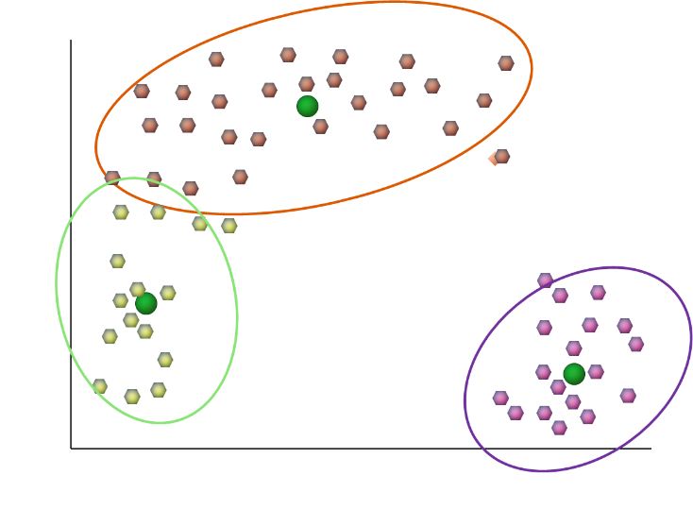
Clustering
Summarization
Words
Sentences
Centroids

Slide 16
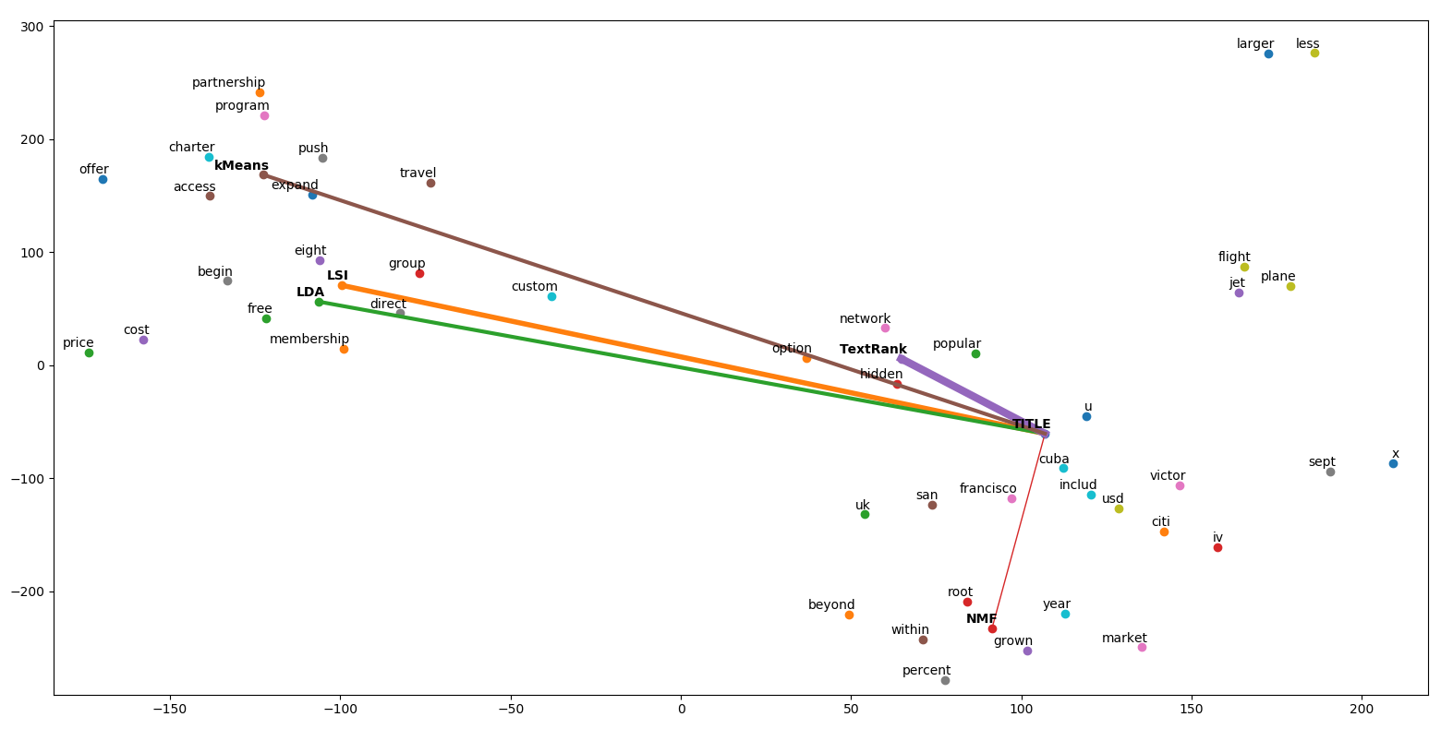
Evaluation metric: cos similarity
Model Evaluation

Slide 17
Evaluation metric: cos similarity
Model Evaluation

Slide 18
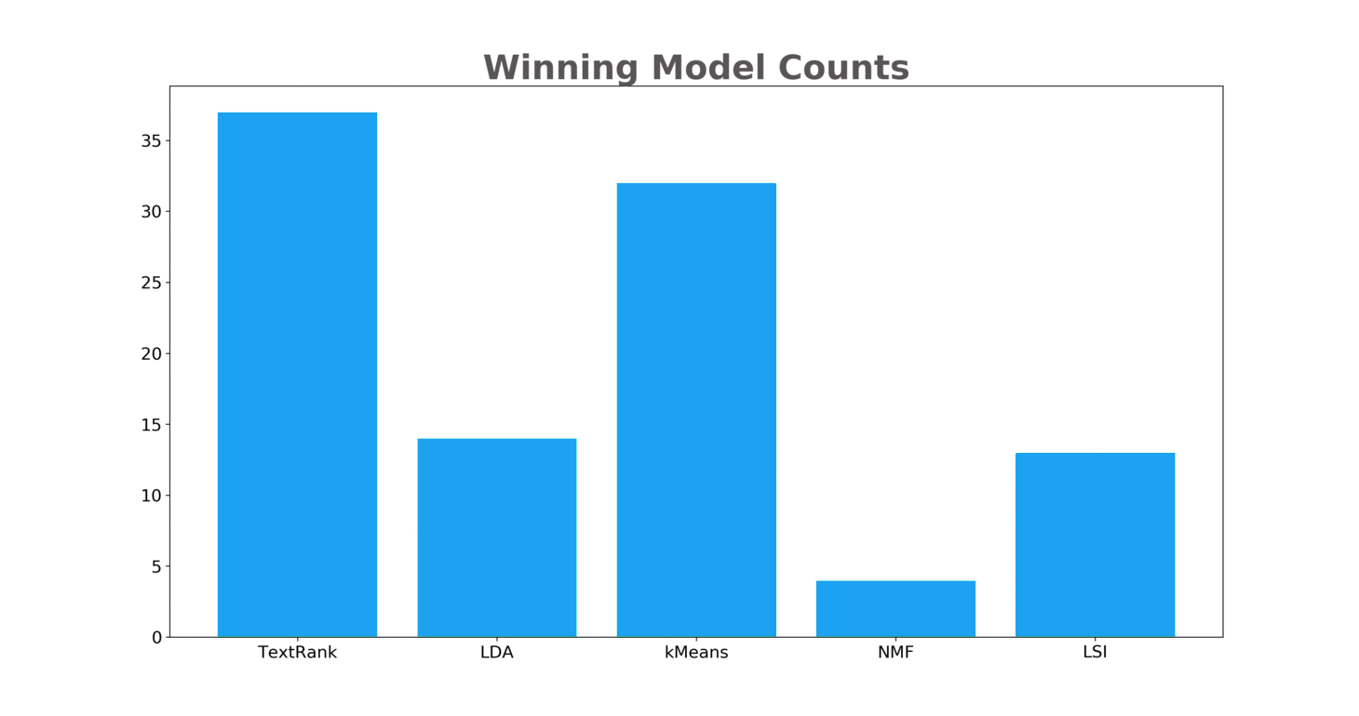
Model performance comparison
Results

Slide 19
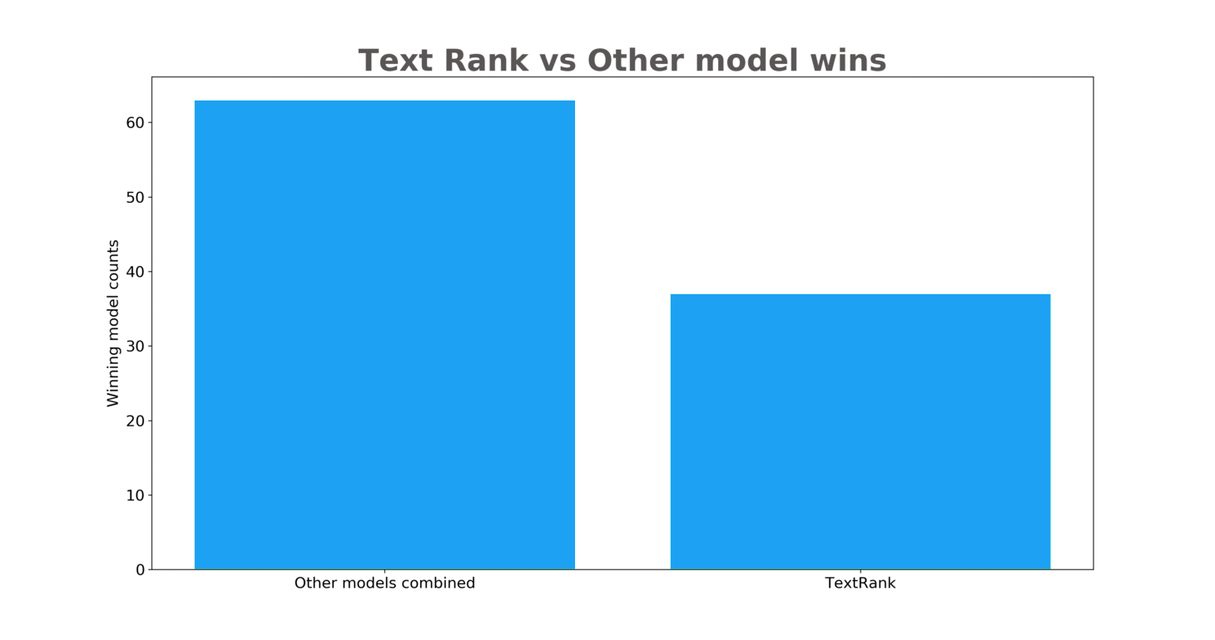
Model performance comparison
Results

Slide 20
Demo Time

Slide 21
Limitations / Further Research
Topic exploration vs. exploitation
Evaluation of methods: quality measure (averaging word vectors), data label (title)
Computational power to make use of state of the art research methods (e.g. ELMO embedding)
Is there a thing such as one single perfect summary?

Slide 22

Our TwitterBot’s Account is already trending!

Slide 23
References
1 Mio News articles DB: http://research.signal-ai.com/newsir16/signalmedia-1m.jsonl.gz
https://simonpaarlberg.com/post/latent-semantic-analyses/?fbclid=IwAR3KLN7IK1yqSjYrOLpYptQoT-x0J7nOk9UblPA2_q2k0sueNdc3FXO_dH4
https://towardsdatascience.com/latent-dirichlet-allocation-15800c852699
https://machinelearningmastery.com/develop-word-embeddings-python-gensim/?fbclid=IwAR34WZEQhnBcb9SuXKKS6Ts7QT9_MS3yjtzljv-YO6rGqt3mUco8SUVM0ic
https://towardsdatascience.com/transfer-learning-using-elmo-embedding-c4a7e415103c
https://towardsdatascience.com/3-silver-bullets-of-word-embedding-in-nlp-10fa8f50cc5a
http://mccormickml.com/2016/04/19/word2vec-tutorial-the-skip-gram-model/?fbclid=IwAR10hQ3nM1i6f7kCD19qToObpijv4qG5DDgwSxbGVuyh5yXrwMgtYuUSMVE
https://towardsdatascience.com/named-entity-recognition-ner-meeting-industrys-requirement-by-applying-state-of-the-art-deep-698d2b3b4ede?fbclid=IwAR1CkxMDT4Kla6GmSF2m5jZ5B6KSslL7P0nBoTfMvU4RajqJS-wjTsyXGsw
https://nlp.stanford.edu/IR-book/pdf/06vect.pdf
https://code.google.com/archive/p/word2vec/
https://medium.com/explore-artificial-intelligence/word2vec-a-baby-step-in-deep-learning-but-a-giant-leap-towards-natural-language-processing-40fe4e8602ba
https://hackernoon.com/understanding-word-embeddings-a9ff830403ce
https://rare-technologies.com/word2vec-tutorial/
https://machinelearningmastery.com/use-word-embedding-layers-deep-learning-keras/

Slide 24
References
https://medium.freecodecamp.org/how-to-get-started-with-word2vec-and-then-how-to-make-it-work-d0a2fca9dad3
https://machinelearningmastery.com/develop-word-embeddings-python-gensim/
https://skymind.ai/wiki/word2vec
http://mccormickml.com/2016/04/19/word2vec-tutorial-the-skip-gram-model/
http://mccormickml.com/2017/01/11/word2vec-tutorial-part-2-negative-sampling/
https://towardsdatascience.com/introduction-to-word-embedding-and-word2vec-652d0c2060fa
https://www.tensorflow.org/tutorials/representation/word2vec#the_skip-gram_model
http://ruder.io/word-embeddings-softmax/
https://medium.com/jatana/unsupervised-text-summarization-using-sentence-embeddings-adb15ce83db1

Slide 25
Backup

Slide 26
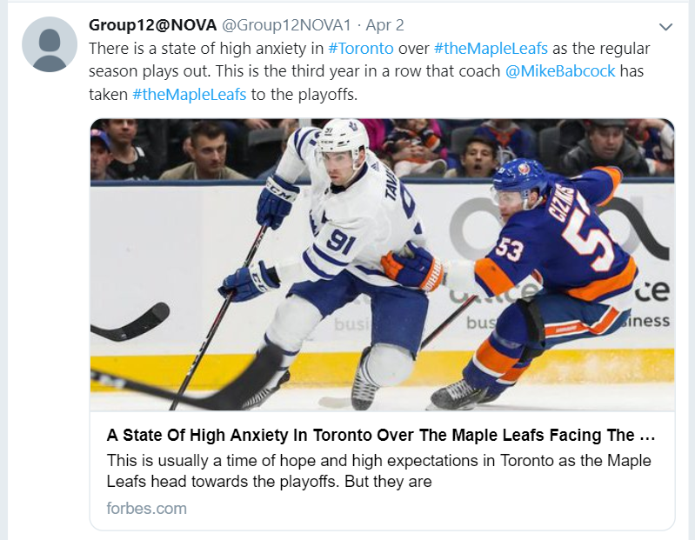

Slide 27
Methods: NER
Spacy performs NER using a modified Bidirectional LSTM Neural Network.
Recognized entities are: PERSON, ORG, NORP, FAC, GPE, LOC, PRODUCT, EVENT, WORK_OF_ART, LAW, LANGUAGE
Recent Research: Deep contextualized word representations using Embedding from Language Models by Google (2018).
https://spacy.io/models; https://towardsdatascience.com/named-entity-recognition-ner-meeting-industrys-requirement-by-applying-state-of-the-art-deep-698d2b3b4ede; https://www.depends-on-the-definition.com/named-entity-recognition-conditional-random-fields-python/?fbclid=IwAR2Z3mJm9EOlgph6qluUCEgcHJsZgpZgy_kOZUFamatOa1XrG51PKNsCuiE

Slide 28
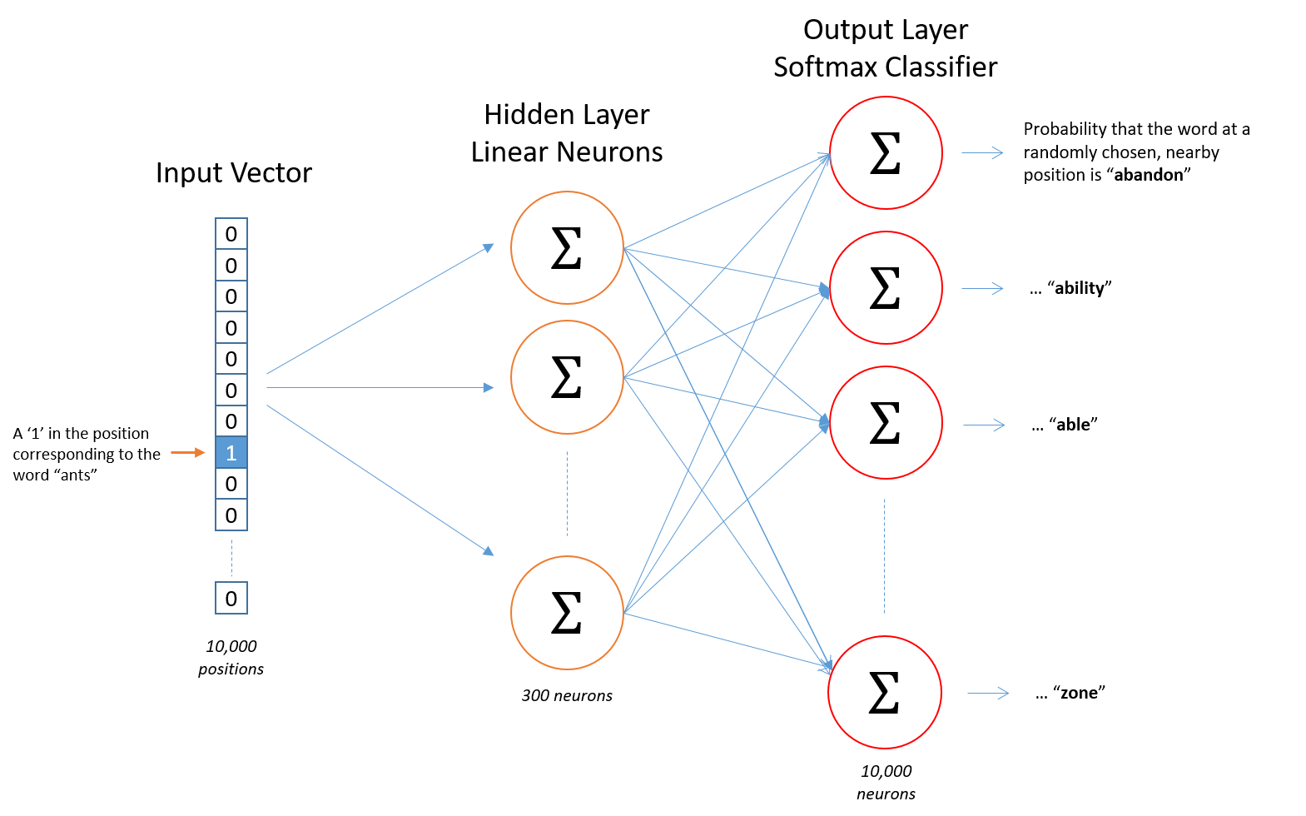
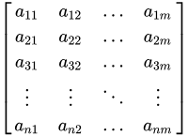
Methods: Word embedding (skip-gram)
Word embedding theory
Weights matrix
(look up table)
...
...
Context
prediction
...
Tomas Mikolov, Kai Chen, Greg Corrado, and Jeffrey Dean. Efficient Estimation of Word Representations in Vector Space. In Proceedings of Workshop at ICLR, 2013.

Slide 29
Methods: Word embedding
GloVe trained model Our Google model
Trained on Wikipedia articles with 6 billion tokens
300-dimensional vectors
Size ~ in 822 mb
Trained on 1 million news articles
300-dimensional vectors
Size ~ in 58 mb
Google Trained model
News dataset (about 100 billion words)
300-dimensional vectors
Size ~ 3.5 GB min RAM: 8GB

